Slide 1
Intelligent Charging Solutions
Home, Office, Roadside
Lucio Tropea – Enel X Global Marketing

Slide 2
Enel X
Company Business Profile
E-city
Smart lighting
Fiber optic wholesale network
Distributed generation & energy services
Demand response and demand side management
E-mobility
Charging infrastructure (public & private)
Maintenance and other services
Vehicle Grid Integration
OEM back-end integration
E-industries
Consulting and auditing service
Distributed generation on/off site
Energy efficiency
Demand response and demand side management
E-home
Installation, maintenance and repair services
Automated home management
Financial services
Home 2 Grid

Slide 3


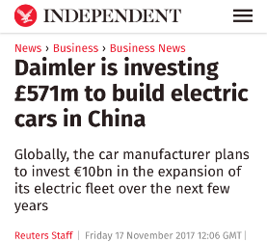
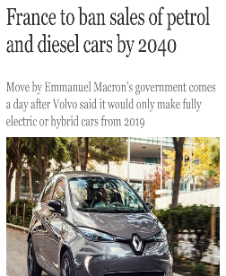

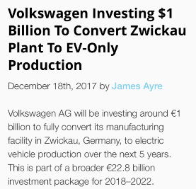




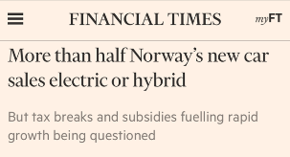

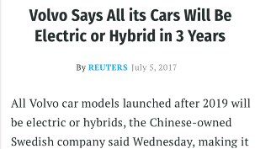







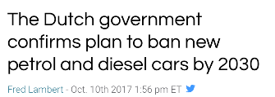
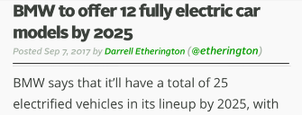



e-Mobility
The world goes to e-Mobility: governments and electric car manufacturers are announcing daily plans for the growth of electric vehicles

Slide 4
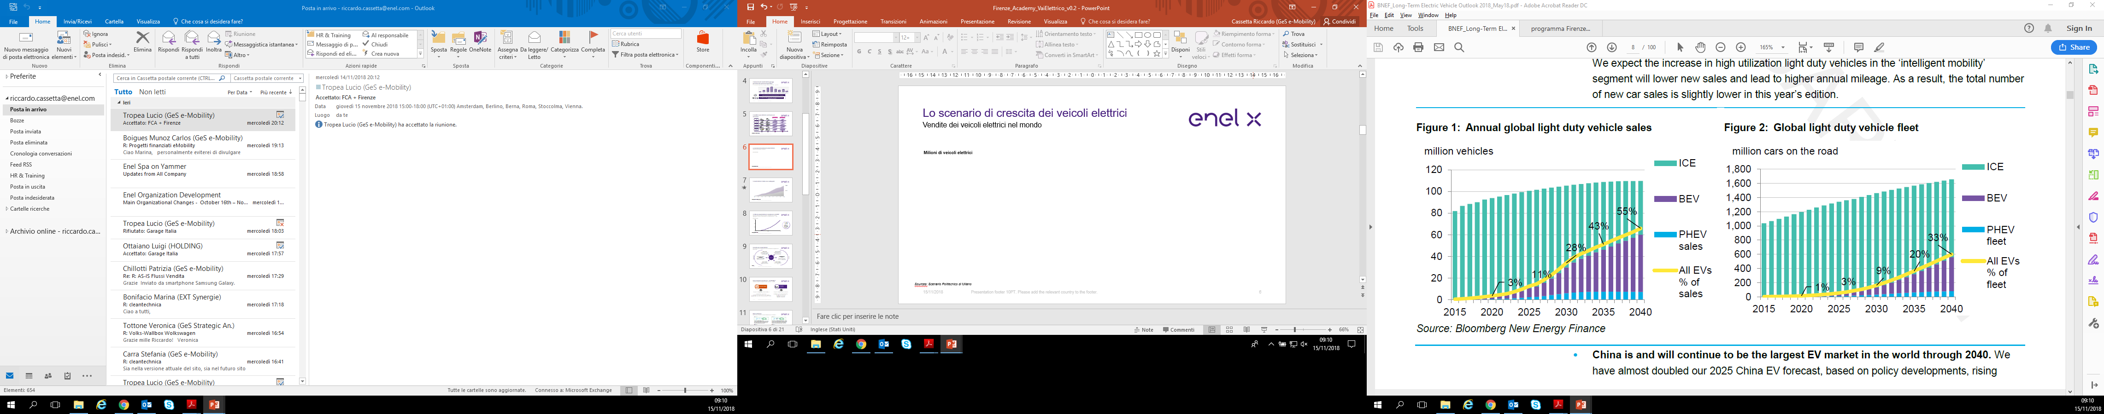
Electric Vehicle scenario
Sales
Cars on the road
Sources: BNEF - Long-Term Electric Vehicle Outlook 2018

Slide 5
Electric Vehicles doubling in Italy
7.063
3.517
Sources: UNRAE / January - September, BEV + PHEV

Slide 6
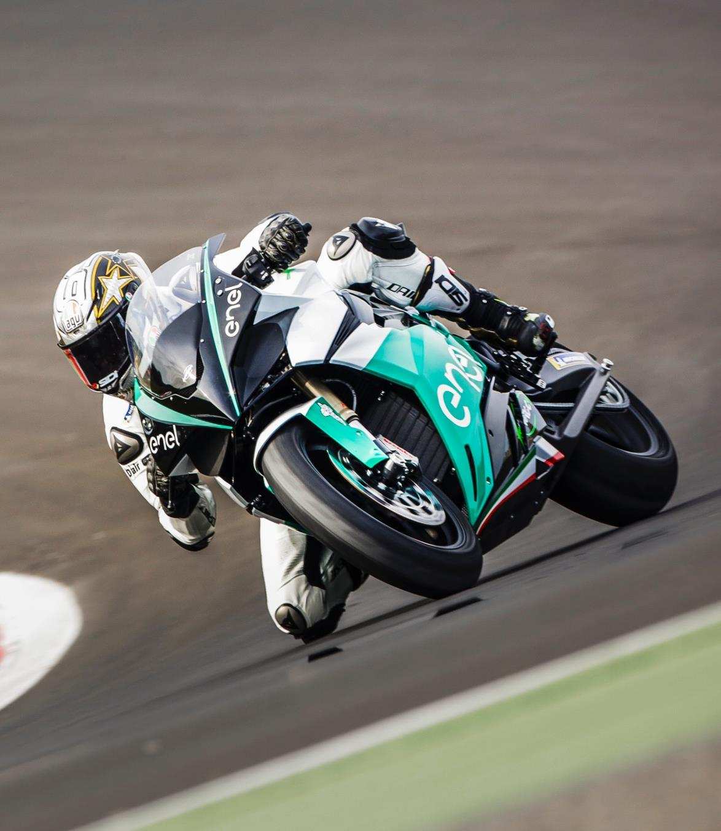
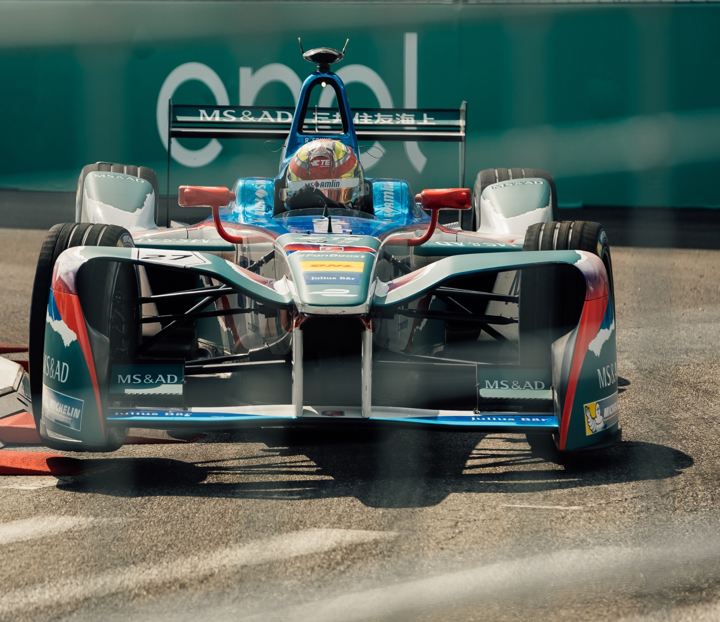



Slide 7
Range anxiety
1
Products
2

Slide 8

2
Range anxiety
1
Products
2
1
  Range
  Charging speed
  Infrastructure density
  Charging Experience (POC vs Load Area, Plug&Charge, Tethered/Socket…)

Slide 9

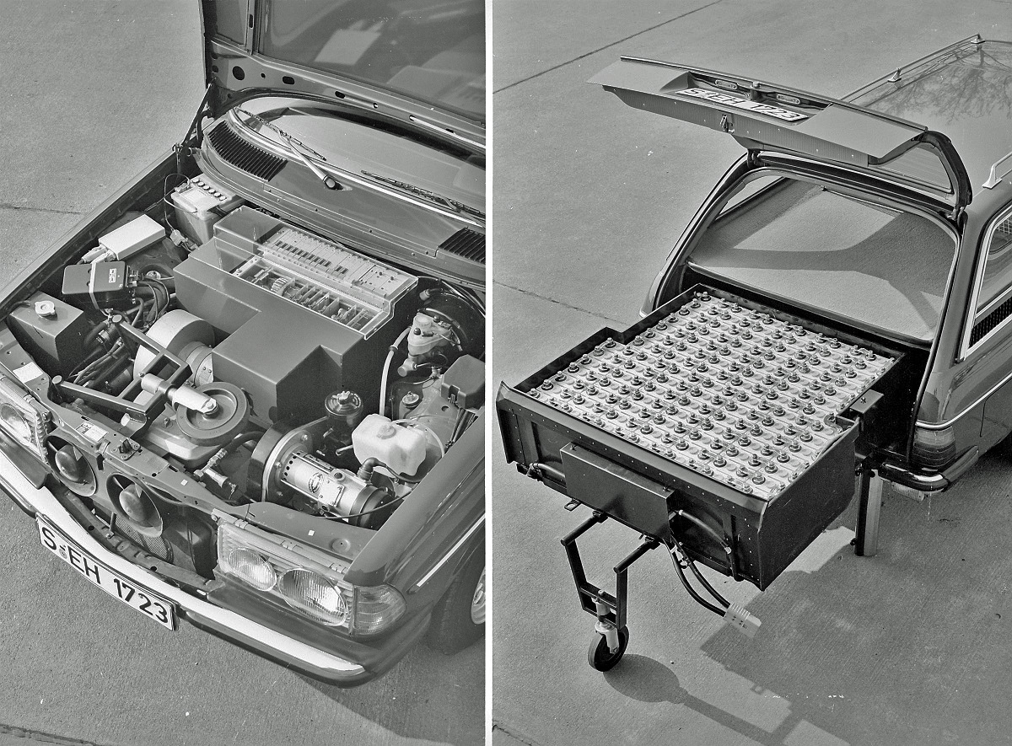
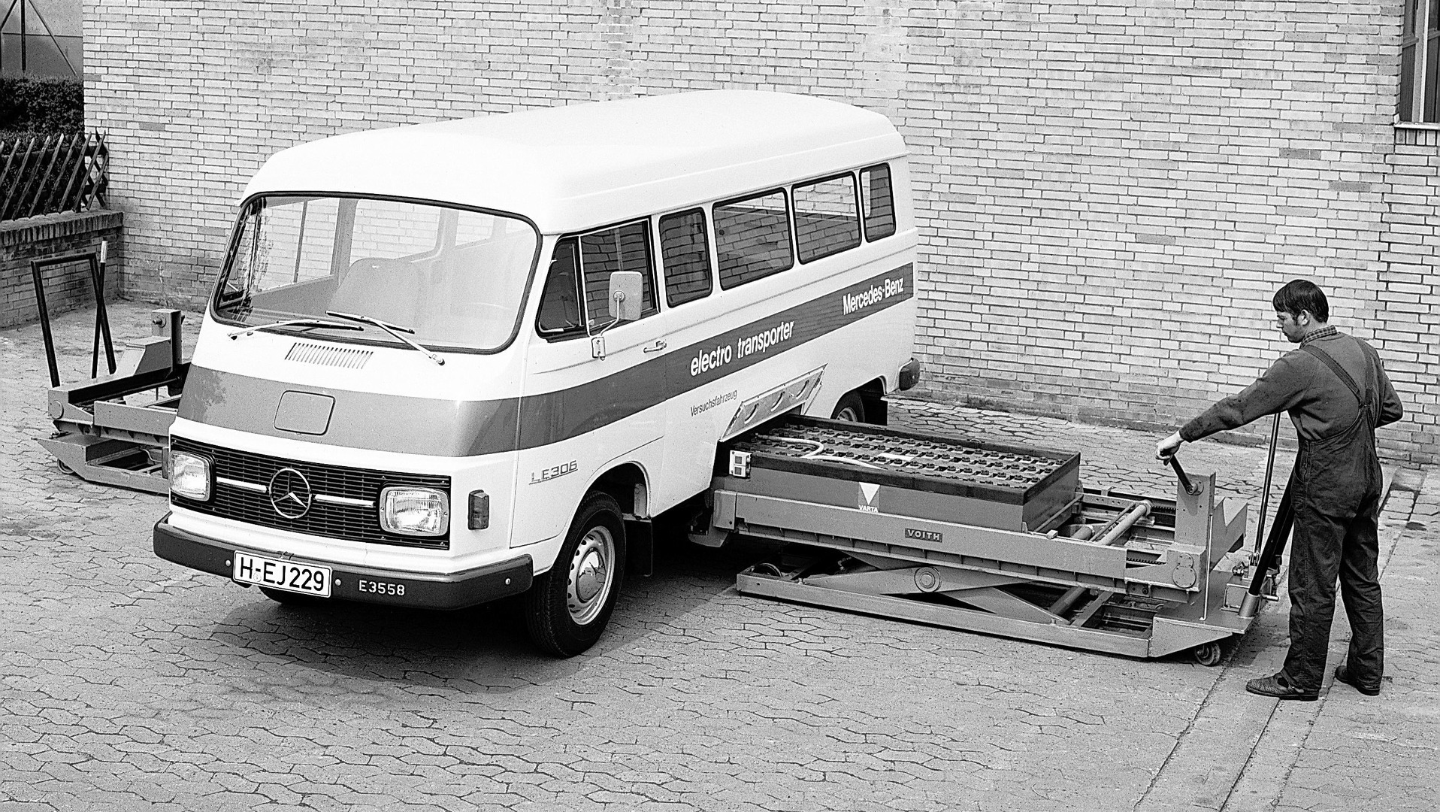

Slide 10
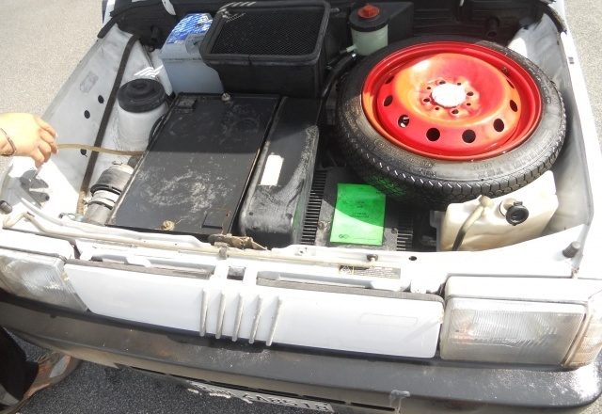
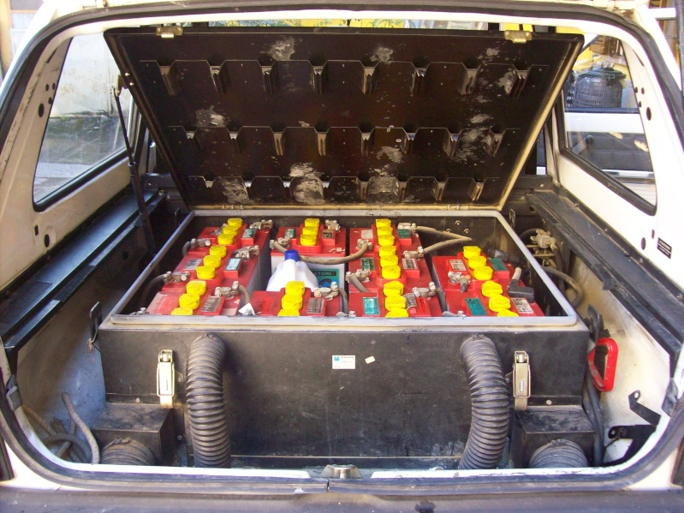
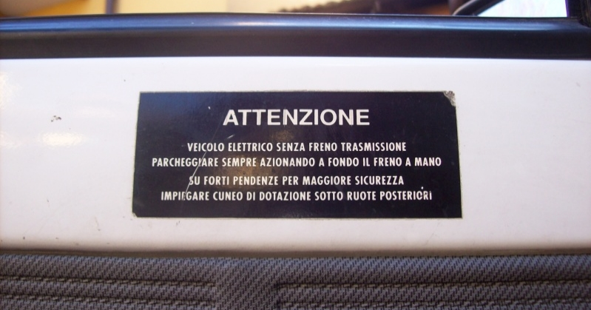
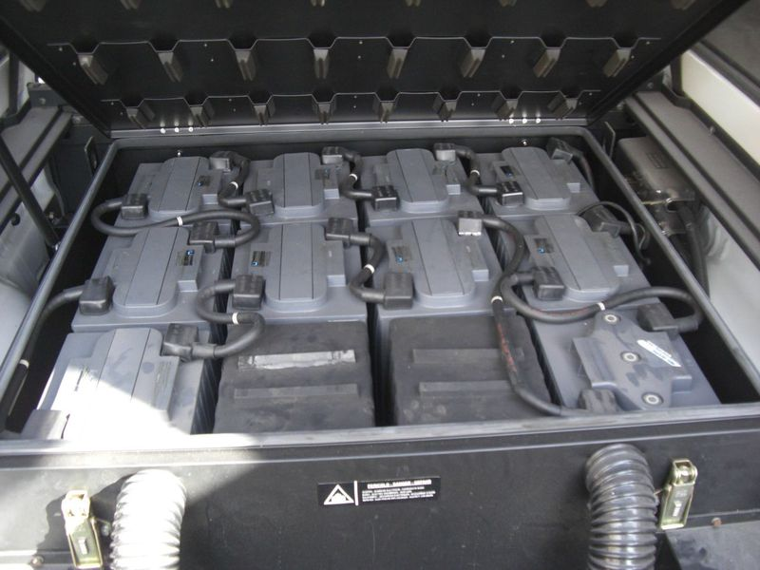
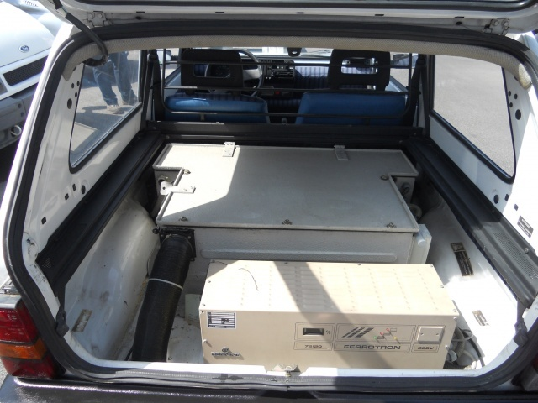

Slide 11
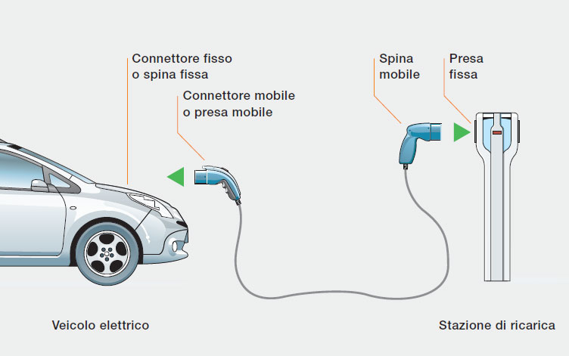
Quanto dura una ricarica?
Gli elementi che contribuiscono a stabilire la velocità di ricarica sono:
Potenza erogata dalla rete elettrica
Stazione di ricarica
Cavo di ricarica
Charger del veicolo elettrico
Capacità assorbimento batteria del veicolo elettrico
La velocità di ricarica è dato dal valore minimo tra le 5 grandezze sopra

Slide 12
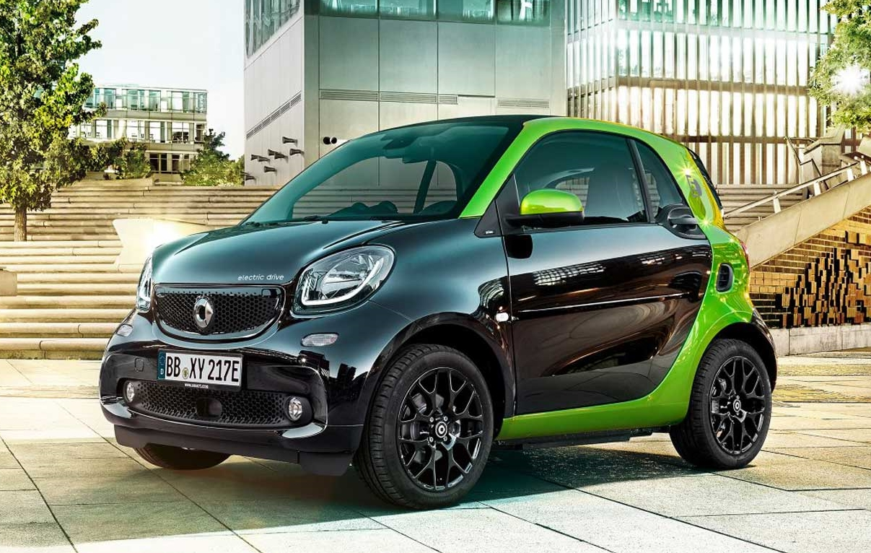
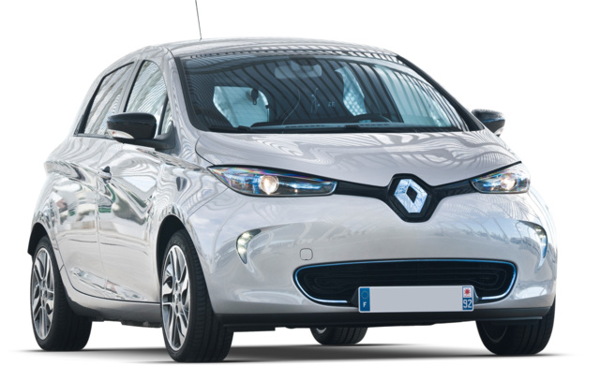
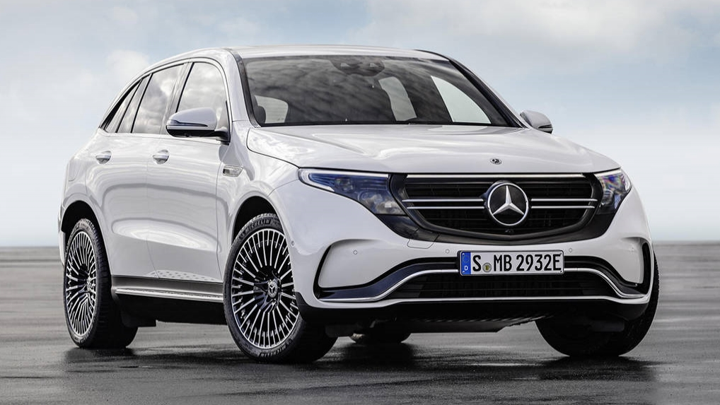
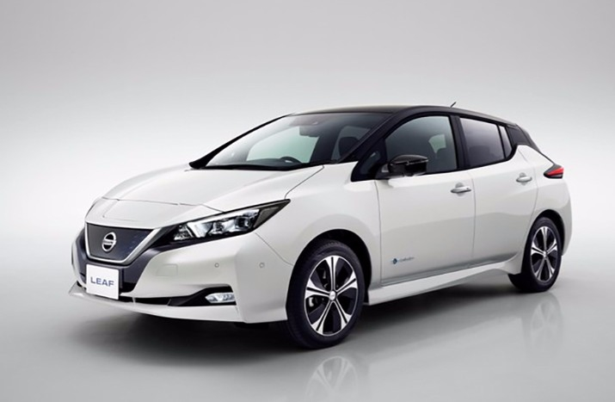
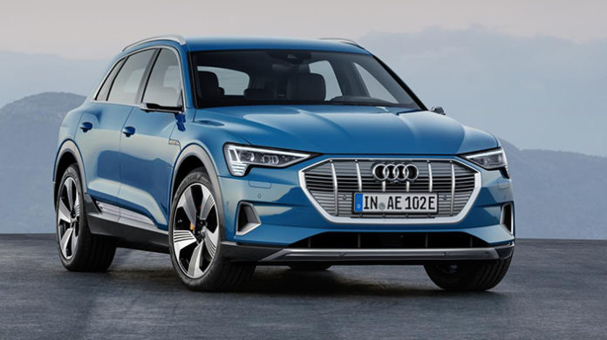
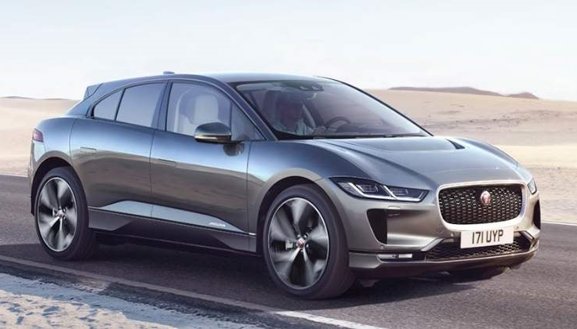

Slide 13
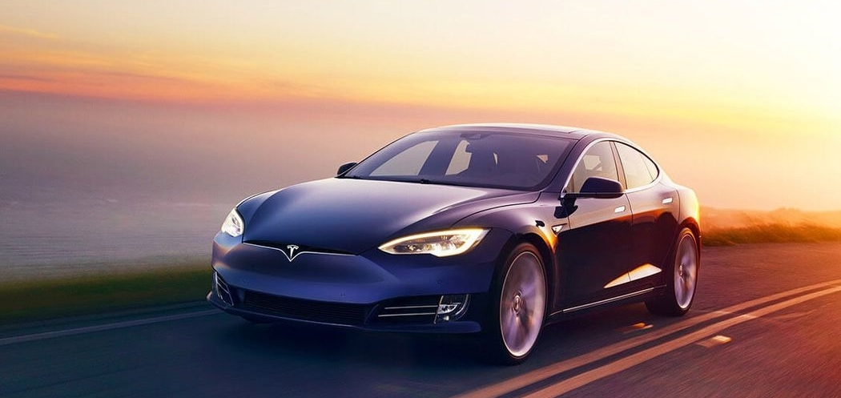
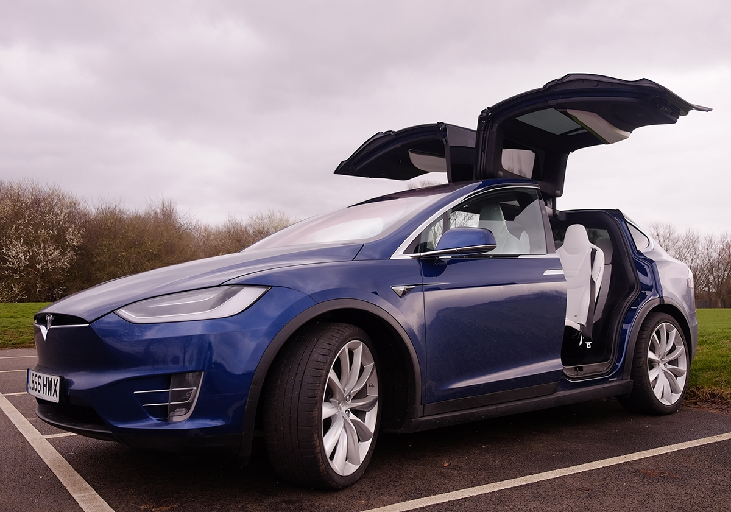
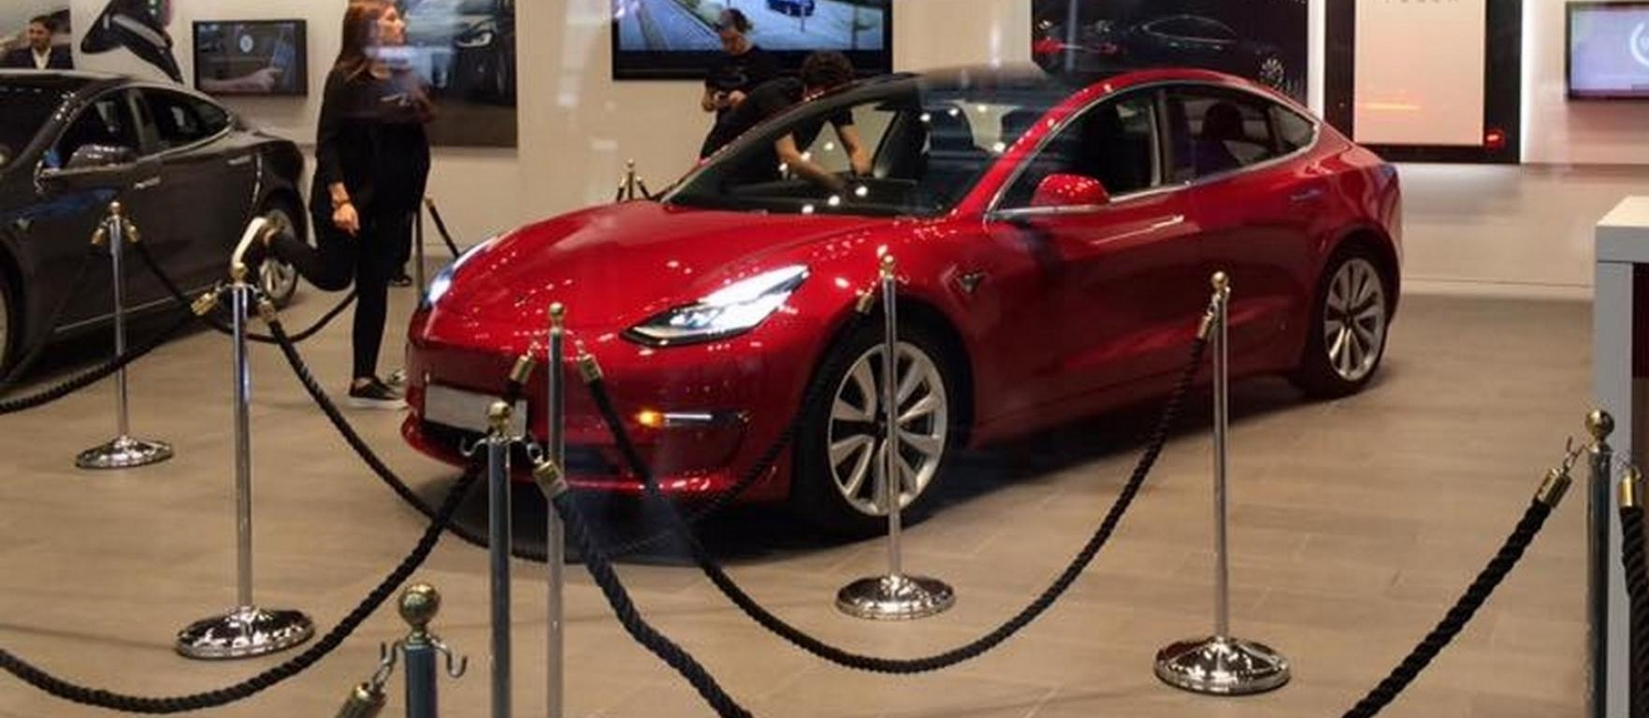

Slide 14

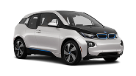
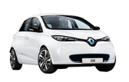

L’autonomia dei veicoli elettrici già oggi garantisce gli spostamenti giornalieri
% di spostamenti giornalieri per range di distanza chilometrica percorsa
27%
22%
15%
13%
8%
10%
5%
2%
< 2 km
2-8 km
9-25 km
26-50 km
51-70 km
71-100 km
101-200 km
201+ km
Nissan Leaf garantisce l'autonomia degli spostamenti nel 95% dei casi
Nissan Leaf
Altri modelli quali, BMW i3, Renault Zoe e Smart garantiscono l'autonomia degli spostamenti nel 90% dei casi
BMW i3
Renault Zoe
Smart elettrica

Slide 15

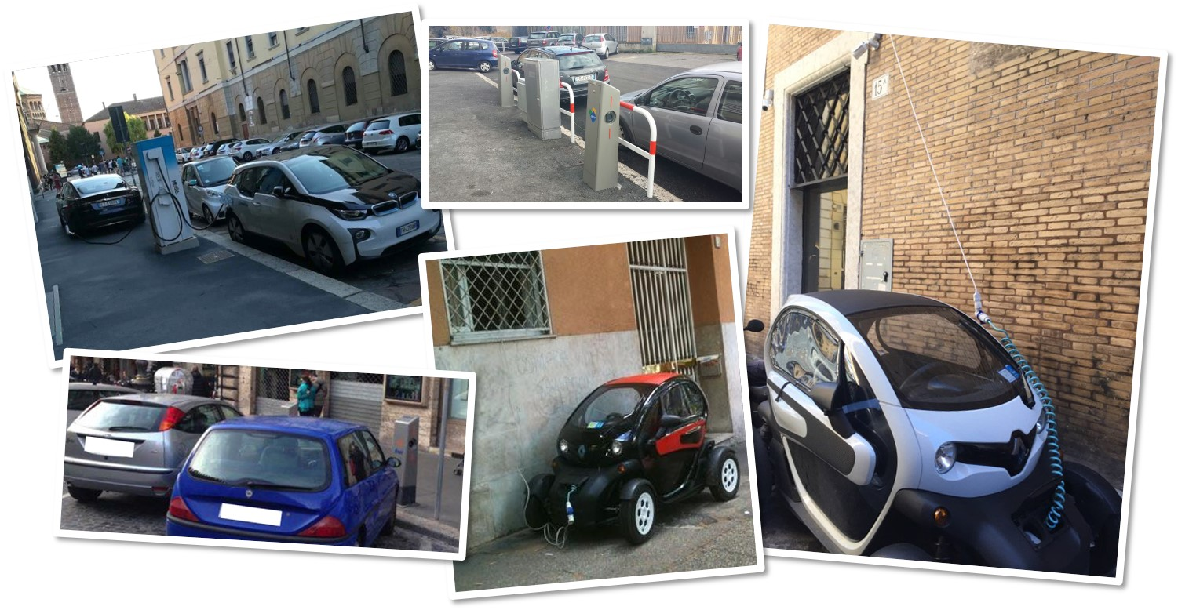
Desperate charging

Slide 16
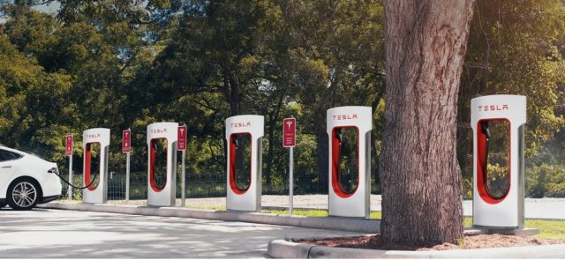
Tesla Supercharger

Slide 17
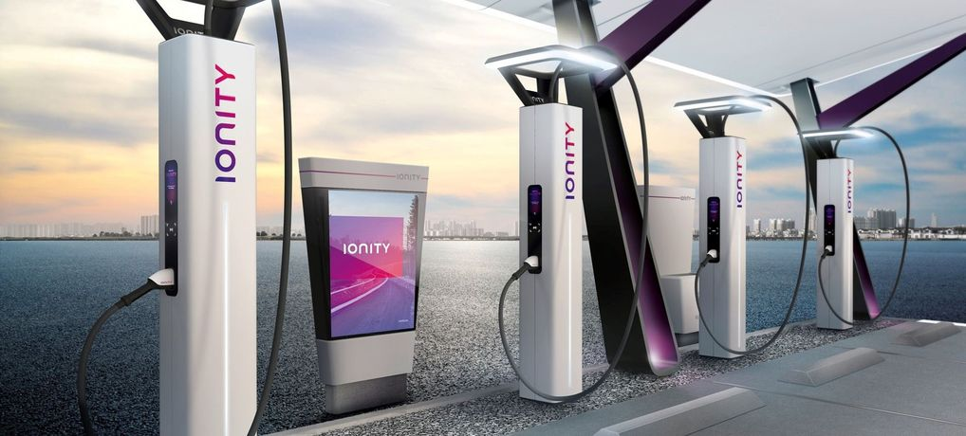
Ionity

Slide 18
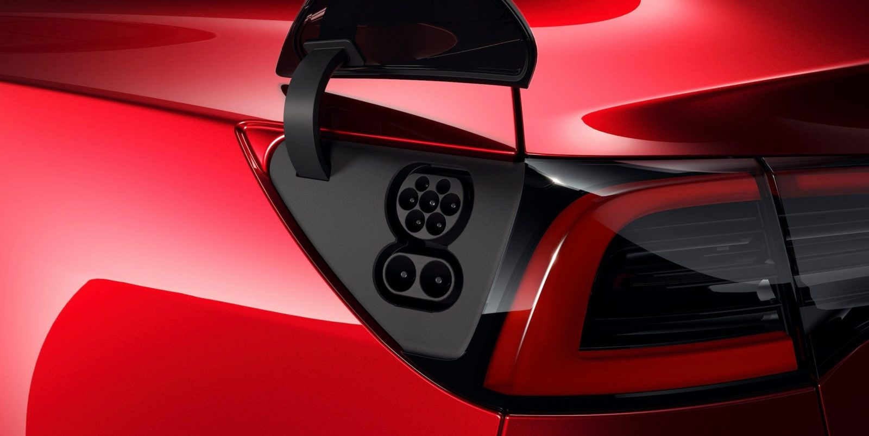
Tesla CCS socket

Slide 19

Il piano di Enel X per la rete pubblica italiana
Enel X installerà 28,000 POC (Point Of Charge) entro il 2022, con un investimento totale che si attesta tra i 100M€ e i 300M€
14.000 Point Of Charge entro il 2020
28.000 Point Of Charge entro il 2022
Investimento totale compreso tra 100M€ e 300M€
28,000
21,000
14,000
10,000
5,400
2018
2019
2020
2021
2022
Quick Stations
Fast & Ultra Fast stations

Slide 20
2
Range anxiety
1
Products
2
1
  Range
  Charging speed
  Infrastructure density
  Charging Experience (POC vs Load Area, Plug&Charge, Tethered/Socket…)
  Listprice vs TCO
  Monetary incentives/pen
  Non monetary (bans, 0emissions areas, speed limits)

Slide 21

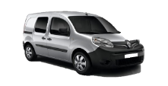

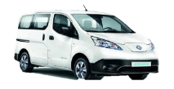

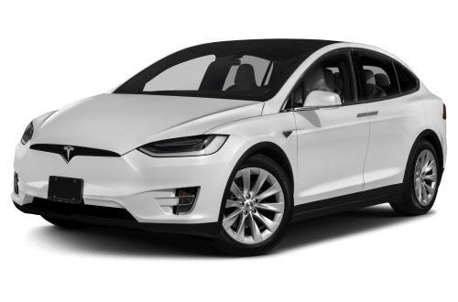
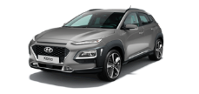
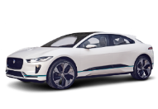






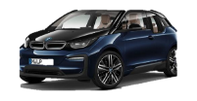


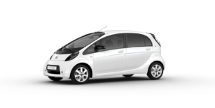
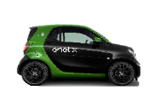

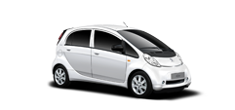
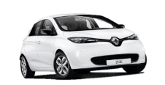

EV Models launch
50 New Launches
41 New Launches
VAN
SUV
Full-size Car
Mid-size Car
Micro & Compact Car
2017
2018
2019
2020
Sources: BNEF 2018 – New Global EV Launches

Slide 22
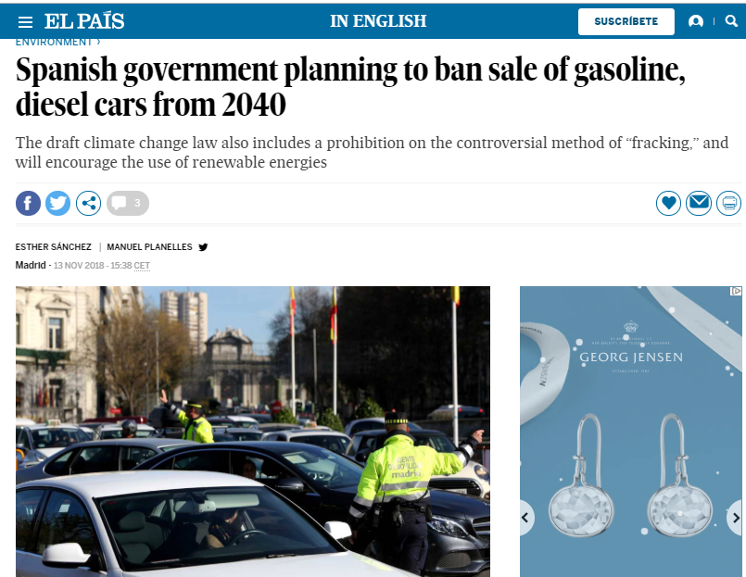

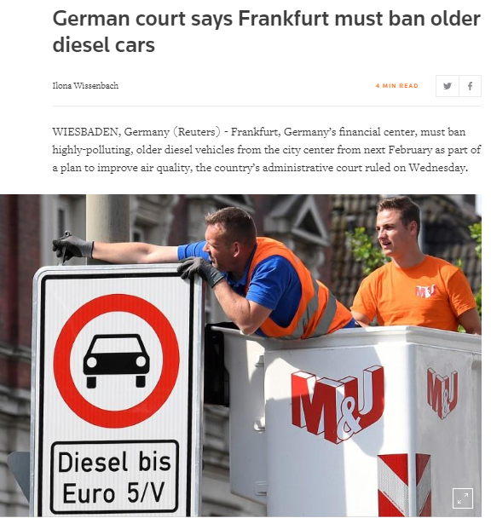

Government bans

Slide 23
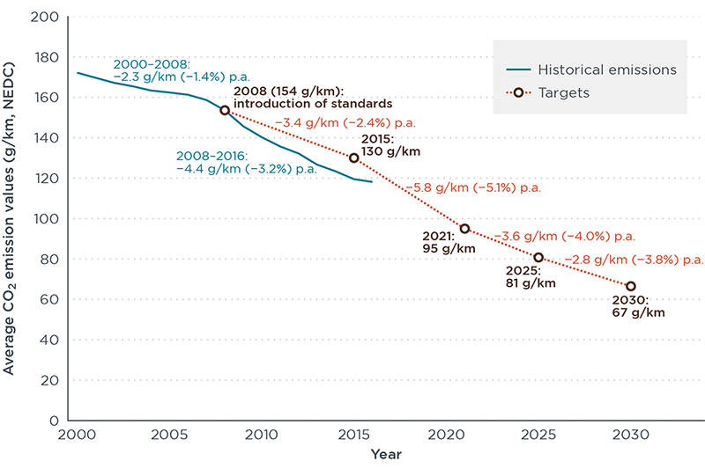
CO₂ Emissions reduction targets
The EU proposed cars standards set a reduction target of 15% for 2025 and 30% for 2030 relative to 2021 reference targets
Starting from 2021, the emission targets will be based on the new emissions test procedure, the Worldwide Harmonized Light Vehicle Test Procedure (WLTP), introduced on 1st September 2017, designed to deliver test results that more accurately reflect real driving behavior than the previous NEDC.
In 2015, the EU starts to implement the new RDE test procedure for measuring vehicle emissions. The goal is to establish a more representative pollution test for cars. It will apply to all new cars by the beginning of 2021.
Source: icct – The International Council on Clean Transportation
The European Commission regulatory proposal for post-2020 CO2 targets for cars and vans: A summary and evaluation – January 2018

Slide 24

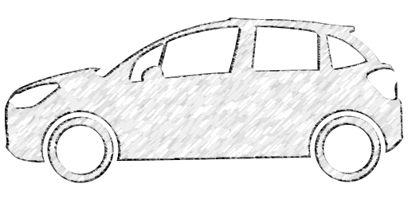
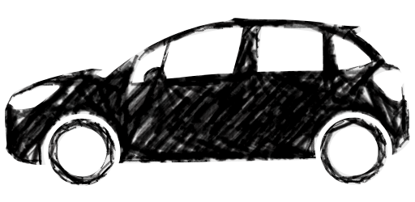
Status on CO₂ Emissions
The average CO₂ emissions of a manufacturer's fleet exceed its limit value in any year from 2012.
From 2019, the cost for each car registered will be €95 from the first gram of exceedance onwards.
BMW
Current Status
DAIMLER
VOLSWAGEN
Forecast emission on 2021
FCA
VOLVO
2021 Target
CO₂ emissions
HYUNDAI-KIA
FORD
RENAULT-NISSAN
TOYOTA
PSA + OPEL
JAGUAR-LR
70
80
90
100
110
120
130
140
CO₂ g/km
Sources: PA Consulting – Automotive News

Slide 25
2
Range anxiety
1
Products
2
1
  Range
  Charging speed
  Infrastructure density
  Charging Experience (POC vs Load Area, Plug&Charge, Tethered/Socket…)
  Listprice vs TCO
  Monetary incentives/pen
  Non monetary (bans, 0emissions areas, speed limits)

Slide 26
Electric Vehicles benefits
In the future, e-Mobility will help to support and push some macro-trends
Ageing society
More advanced navigation and satellite navigation models allow optimized and simplified management compared to traditional cars
Smart city logistics
Smarter mobility from the point of view of consumption and overall dimensions, noiselessness (relevant to historic city centers) and absence of emissions
Sustainability
Vivibility
e-Mobility
Urbanization and proximity mobility
Less space and better traffic management, thanks to the use of reserved lanes and access to ZTL areas
Connectivity and autonomous driving
Simplified technology for electric vehicles compared to traditional power supply; self-driving electric vehicles have better performance
Sharing economy
Easier for shared transport services, even for lower costs
Circular economy
Increased vehicle components that can be recycled (eg batteries)
Sources: Enel

Slide 27


Slide 28

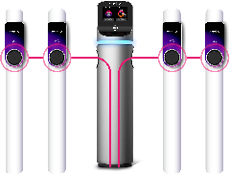





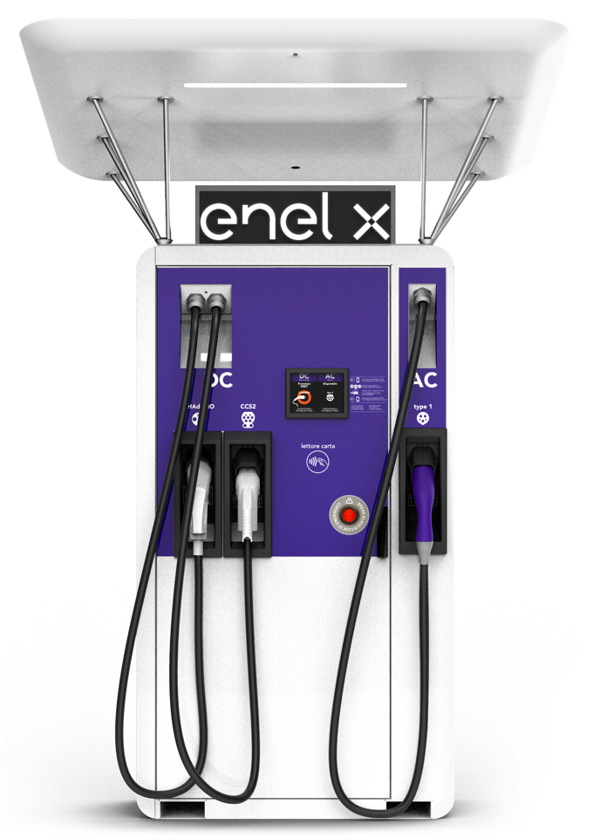



Intelligent Charging Solutions
@ BUSINESS
JuiceBoxC
AC up to 22 kW
JuiceBox
AC up to 22 kW
JuiceStation
AC up to 22 kW
@ HOME
INTELLIGENT CHARGING SOLUTIONS
@ ON THE ROAD
JuicePump
AC charging up to 43 kW
DC up to 50 kW
JuiceLamp
AC up to 22 kW
JuicePole
AC up to 22 kW

Slide 29





JuiceBox
JB03
JB07
JB22
JB07
JB22
JuiceBox
JuiceBoxC
COMMERCIAL

Slide 30

JuiceStation
JuiceStation
The solution that growth with you

Slide 31

JuicePole
ICONIC DESIGN

Slide 32



JuicePole
CUSTOMIZABLE

Slide 33





JuicePole
CUSTOMIZABLE

Slide 34

JuicePole
LCD 10’’

Slide 35

JuicePole
CUSTOMIZABLE

Slide 36


JuicePole
Rgb crown led

Slide 37


JuicePole
Easy connect

Slide 38






Enel X Recharge
SAVE YOUR FAVOURITE CHARGING POINT

Slide 39








Main Partnership

Slide 40


VGI (V1G – V2G)

Slide 41


Slide 42
Ten stats
https://www.linkedin.com/pulse/why-we-have-now-reached-inflexion-point-automobile-industry-reid/

Slide 43

Le soluzioni tecnologiche per la ricarica pubblica
Enel X ha un portafoglio completo di soluzioni tecnologiche che soddisfano le esigenze di tutti i clienti
43

